Slide 1
Darwin’s Theory of Evolution
Natural Selection
is the basis of evolution

Slide 2
Developing the theory of evolution
In 1831 Charles Darwin embarked on a journey on the HMS Beagle to survey the coast of South America.
At this time people believed the Earth was only 6,000 years old and that plants and animals were unchanging.
Darwin’s role on this journey was to collect biological and geological specimens.

Slide 3
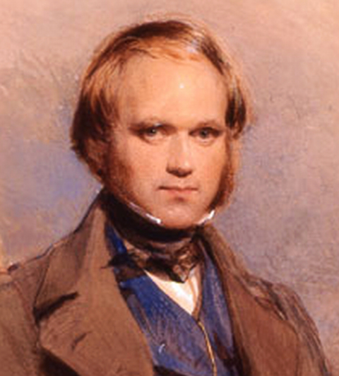
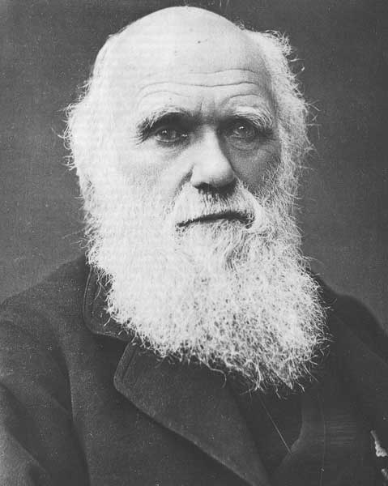
Charles Darwin 1809-1882

Slide 4
The Galapagos Islands
In 1835 the HMS Beagle arrived at the Galapagos Islands off the coast of South America.
Darwin visited each of the islands collecting mockingbirds, finches and other animals. It was then he began to notice that each island seemed to have its own variation of animals.
It wasn’t until years later that another scientist, John Gould, started to classify these birds that Darwin found as separate and unique species.

Slide 5
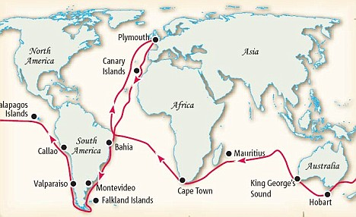
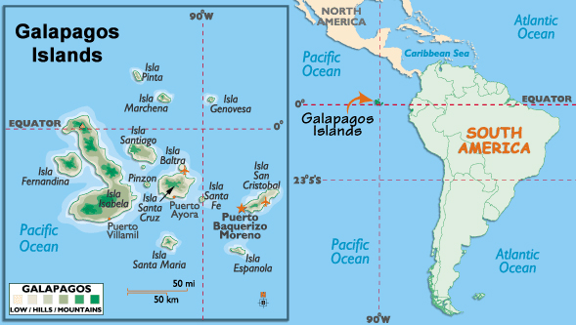

Slide 6
Darwin continued his studies…
Darwin hypothesized that a new species could gradually appear over time through small changes in ancestral species
He discovered that species could be bred to get specific and desired traits. He referred to this type of selective breeding as Artificial Selection
Artificial Selection also occurs when humans develop new breeds of dogs or crop plants.

Slide 7
Natural Selection
Darwin began to reason that some animals that compete for resources are better suited for survival than others. “Survival of the fittest”
Animals that are poorly equipped for survival would most likely die-off.
This process was Natural Selection.
Given enough time, natural selection could modify a species enough to produce a new species.

Slide 8
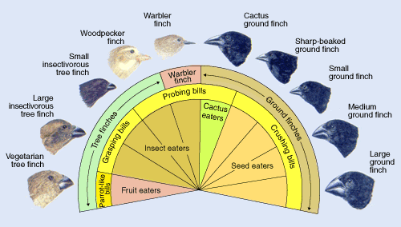
Darwin’s Finches

Slide 9
Darwin’s Theory of Evolution was based on
4 basic principles:
1. Individuals in populations show differences or variations
2. Variations can be inherited, meaning they are passed from parent to offspring
3. Organisms that produce can survive on available resources
4. Variations that increase the reproductive success will have a greater chance of being passed on to future generations

Slide 10
The Origin of Species
Darwin likely developed his theory of evolution by natural selection in 1840.
Soon after he began to write a multi volume book explaining how natural selection might provide a mechanism for the origin of species. He continued to compile evidence to support his theory for many years.
In 1859 Darwin published his book entitled “On the Origin of Species by Means of Natural Selection” In this book the term evolution was only used on the last page.
Today, evolution is a term used to describe cumulative changes in a group of organisms over time.

