Slide 1
The Origin of Species
Darwin likely developed his theory of evolution by natural selection in 1840.
Soon after he began to write a multi volume book explaining how natural selection might provide a mechanism for the origin of species. He continued to compile evidence to support his theory for many years.
In 1859 Darwin published his book entitled “On the Origin of Species by Means of Natural Selection” In this book the term evolution was only used on the last page.
Today, evolution is a term used to describe cumulative changes in a group of organisms over time.

Slide 2
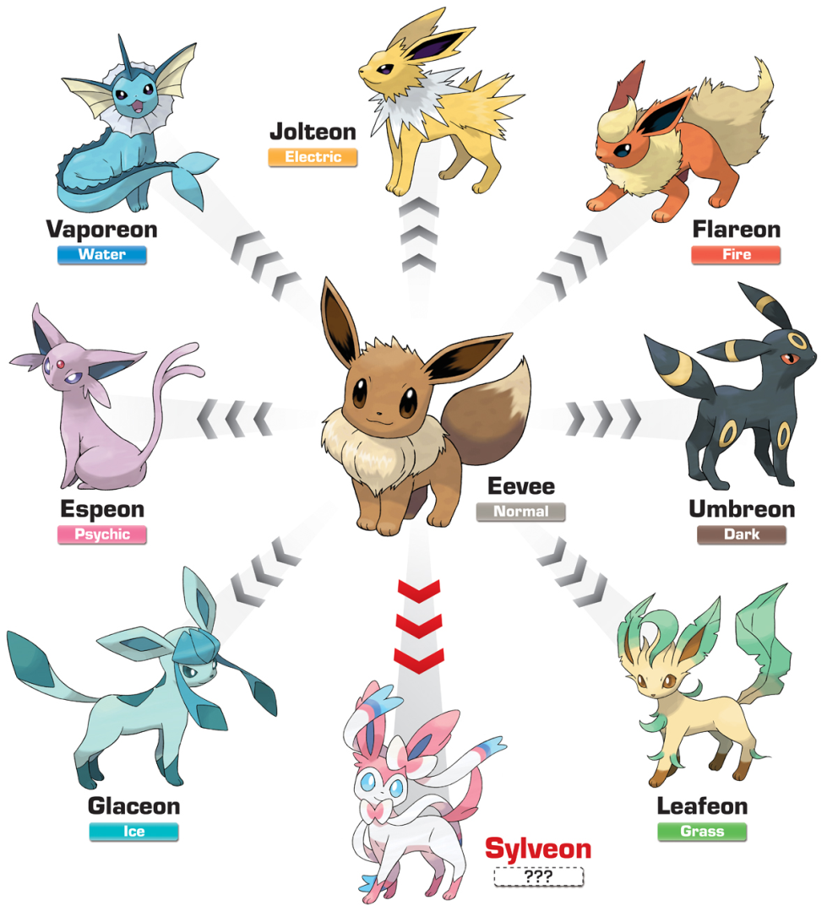
Support Of Evolution
Fossil Records
Comparative Anatomy
Comparative Embryology
Geographic Distribution

Slide 3
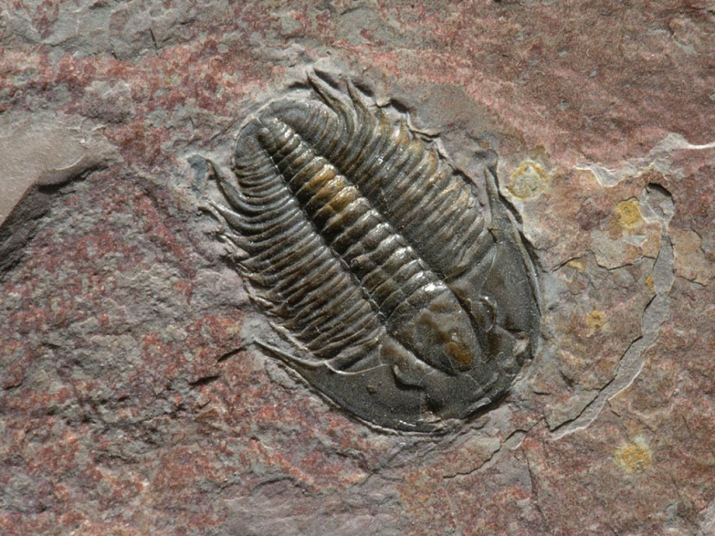
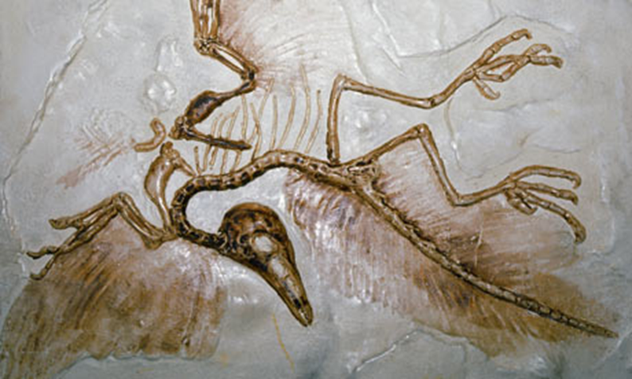
Fossil Record
Fossil are the remains of plants and animals that lived long ago.
These fossil can show us how ancient species are similar to current species or how some species have gone unchanged over millions of years
Fossils can be used to theorize intermediate species and transitional forms of animals such as the Archaeopteryx (the 1st bird)

Slide 4
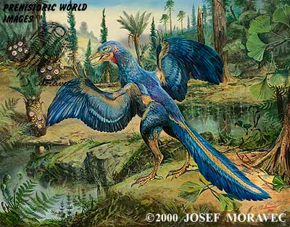
From Dinosaur to Bird…

Slide 5
Transitional Fossils
Scientists study two major traits when classifying transitional fossils.
Derived Traits are newly evolved features that do not appear in common ancestors (Such as feathers)
Ancestral Traits are more primitive features such as teeth and tails that do appear in ancestral forms.
Transitional Fossils provide a detailed pattern of evolutionary change in many modern animals such as horses, whales and humans

Slide 6
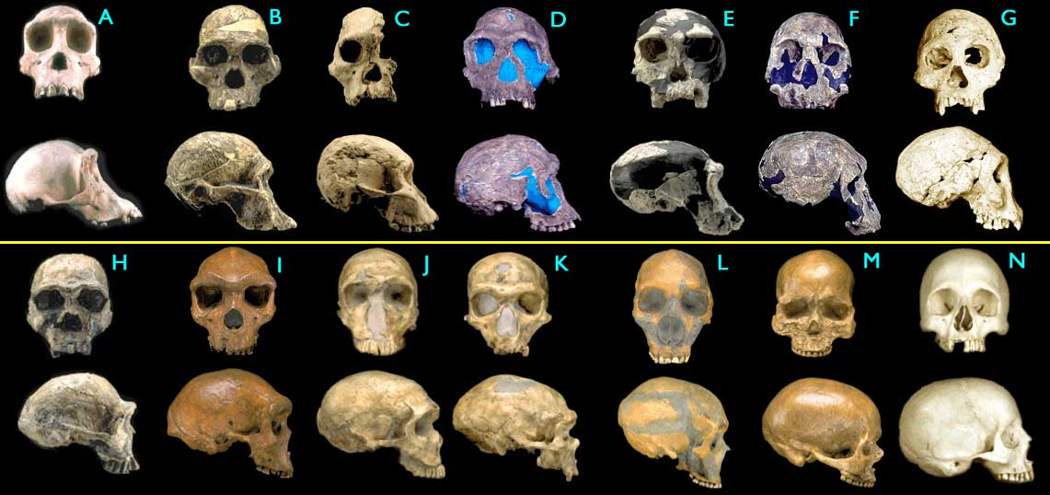
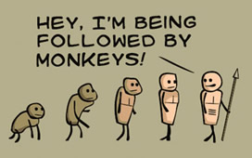

Slide 7
Comparative Anatomy
Anatomically similar structures that are inherited from a common ancestor are called homologous structures.
Vestigial Structures are reduced forms of functional structures in other organisms. Features that are no longer needed in modern organisms get smaller or eventually will become lost (Example our tailbone)
Analogous Structures can be used for the same purpose and look similar but do not derive from a similar ancestor. (Birds and Bees have wings used to fly but do not come from a similar ancestor)

Slide 8
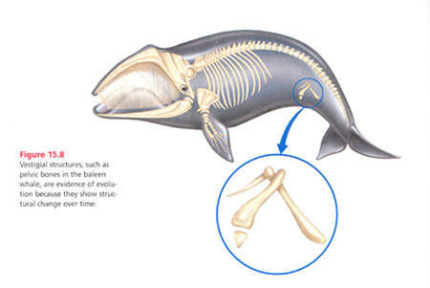
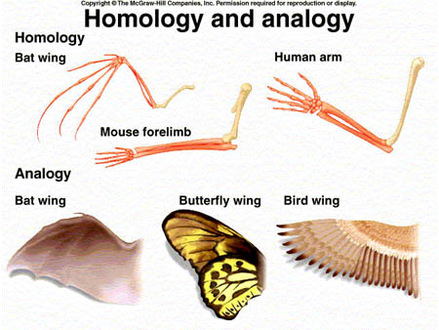

Slide 9
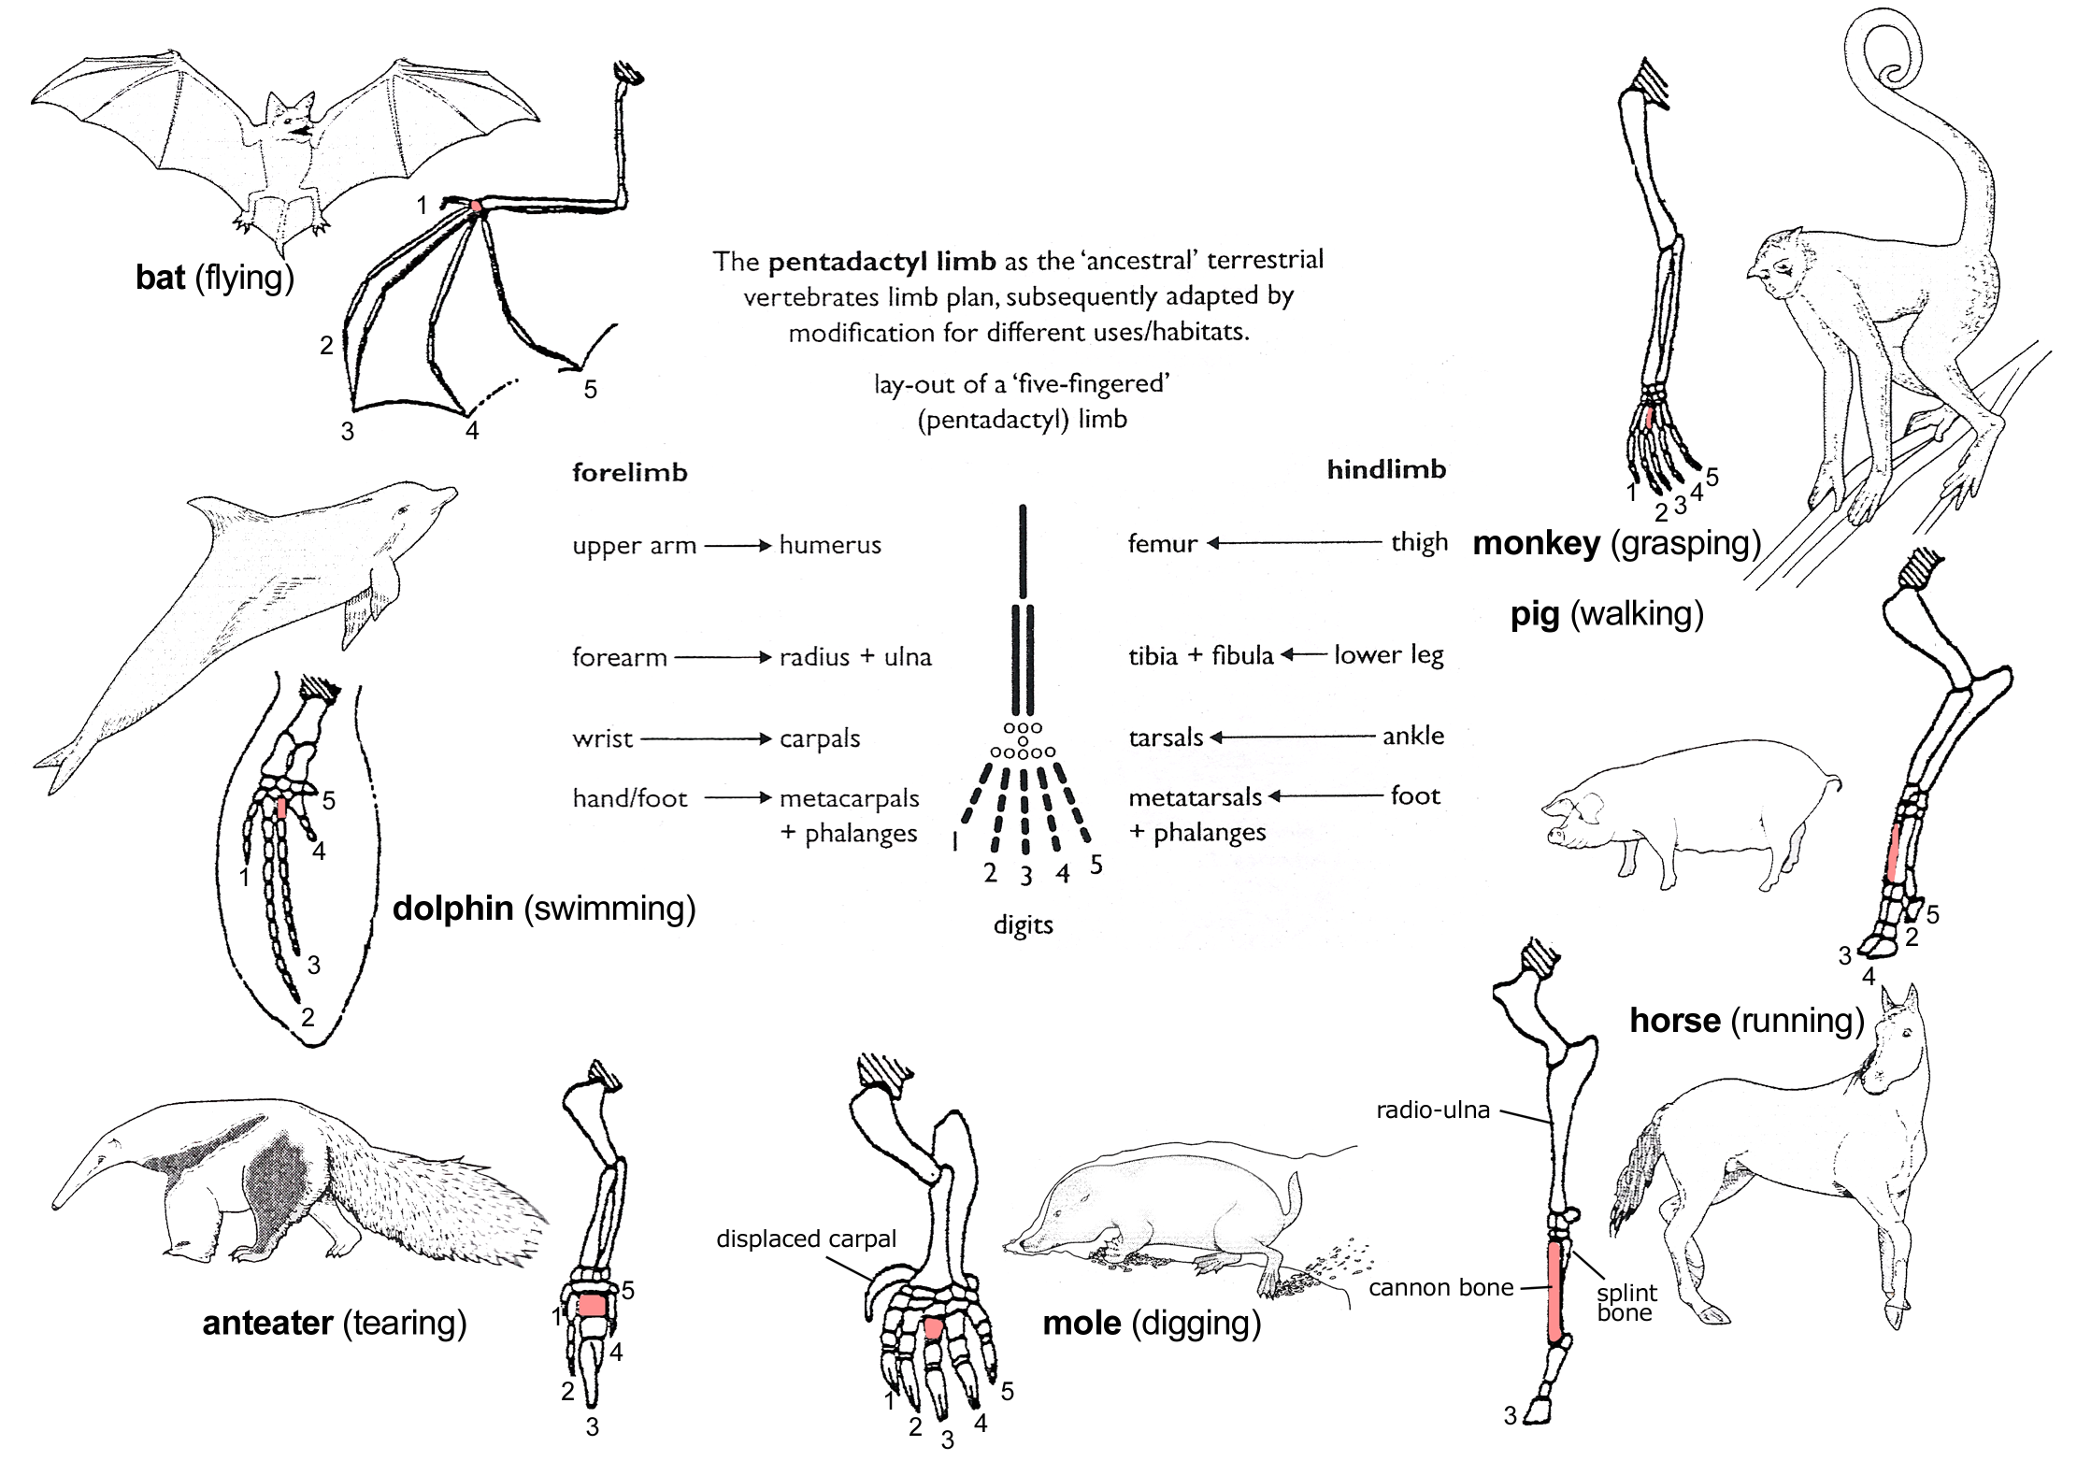

Slide 10
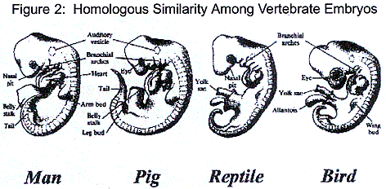
Embryos
An embryo is an early- pre birth state of an organism’s development.
Vertebrate embryos have homologous structures during certain times in their development but look completely different when they become adults.

Slide 11
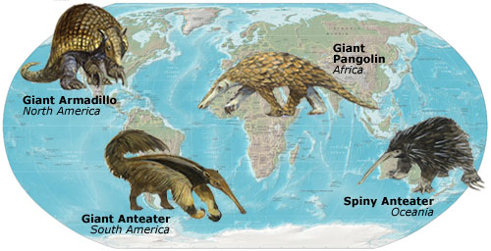
Geographic Distribution
Animals found on different continents share similar features with other species but are more closely related to other animals living in their habitat because of a shared common ancestor.

